Slide 1

Solar Concentrator Efficiency
Analysis – Tracker Shadowing
Presented by
Kyle Stephens
College of Optical Sciences
College of Engineering
Project Mentor: Dr. Roger Angel
of Steward Observatory
April 17, 2010

Slide 2
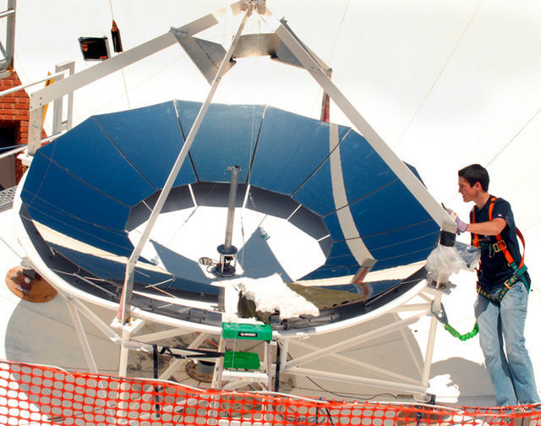
Project Overview
Using slumped parabolic mirrors to concentrate sunlight for more efficient solar power
Using triple-junction solar cells to collect more energy at concentration
Final Goal: $1 per Watt
Current Status: Tracker #1 is under construction
Image Source: Xavier Gallegos/ Tucson Citizen

Slide 3
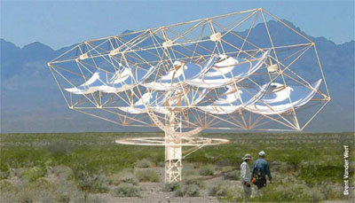
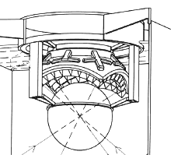
Project Overview
Receiver:
Image Source: http://www.rehnu.com/
Image Source: http://www.rehnu.com/
Final tracker design to be 2 by 6 grid of mirrors
Receiver consists of 36 high concentration cells

Slide 4
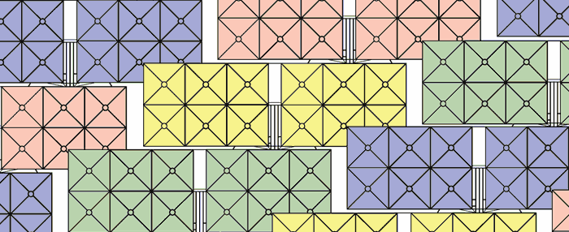
The Problem
Solar farms need to be compact to save on the costs associated with purchasing land
Solar trackers in close proximity to each other will self-shadow at low solar altitude angles
Image Source: http://www.rehnu.com/gw-farm.php

Slide 5
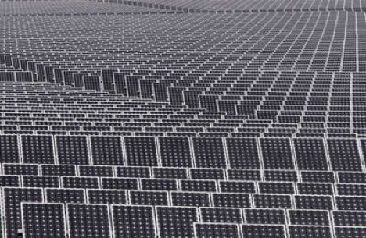
Questions to Consider
For a given tracker, what spacing will maximize the sunlight collected while still making
an efficient use of the land?
At what point will the losses
due to increasing air mass
negate any effort to reduce
self-shadowing?
Image Source: http://www.treehugger.com/solar-farm-array-bavaria.jpg

Slide 6
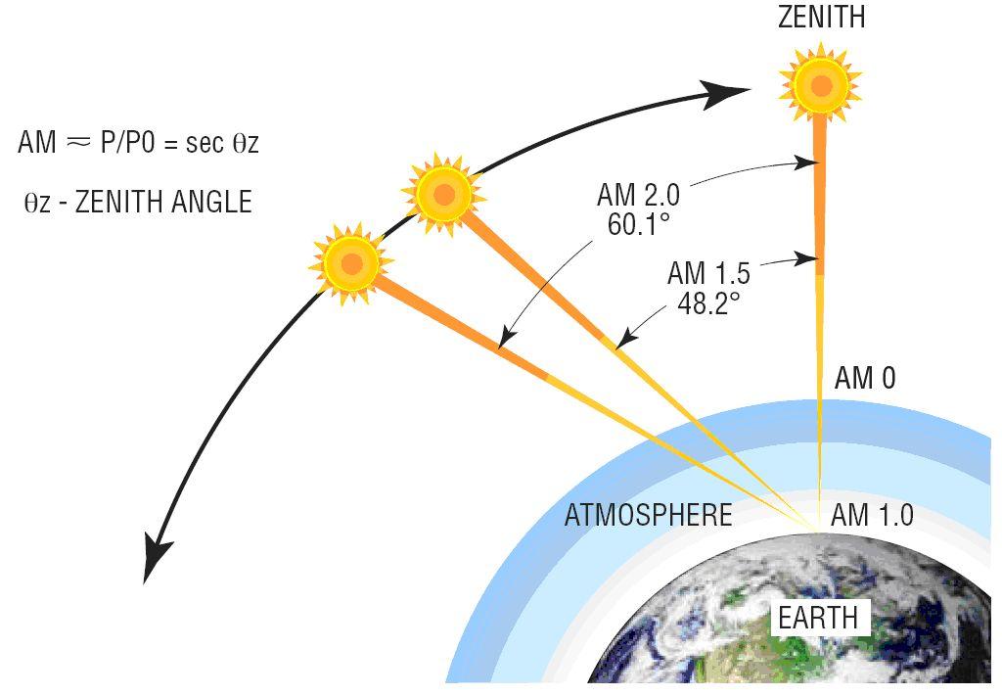
Air Mass
Definition: the optical path length through Earth's atmosphere for light from a celestial source
Image Source: http://images.pennnet.com/pnet/surveys/lfw/newport_jeong_fig_1.jpg

Slide 7
Approach
Several different MATLAB programs were created to accomplish a few goals:
  Quantify tracker shadowing for a given solar altitude and azimuth angle
  Display the effect of tracker shadowing for a given day throughout the year
In all cases, the tracker separation, location (latitude), and tracker size was kept the same.

Slide 8
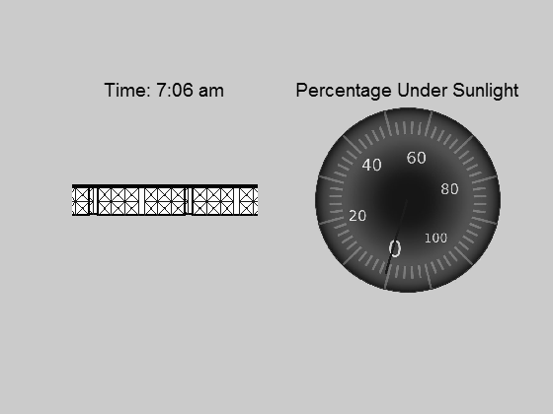
Shadowing at Winter Solstice

Slide 9
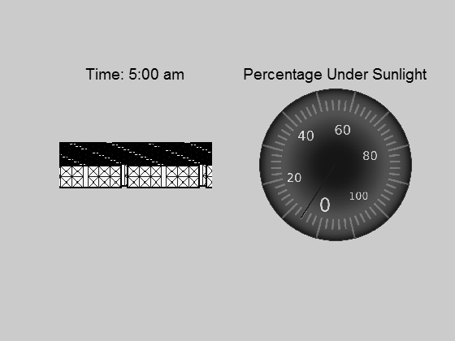
Shadowing at Summer Solstice

Slide 10
Irradiance Calculation
An equation for irradiance was used (as a function of increasing air mass) and then compared to the shadowing data to see total losses. The equation:
I(z) = I₀ e^{-c[sec(z)]} (1)
_{s}
I₀ = 1.353 kW/m²
z = zenith angle (90° – altitude angle)
Two empirical constants: c = 0.357, s = 0.678
(1) Source: Meinel, Aden B. and Marjorie P. Meinel. Applied Solar Energy: An Introduction. 1977.

Slide 11
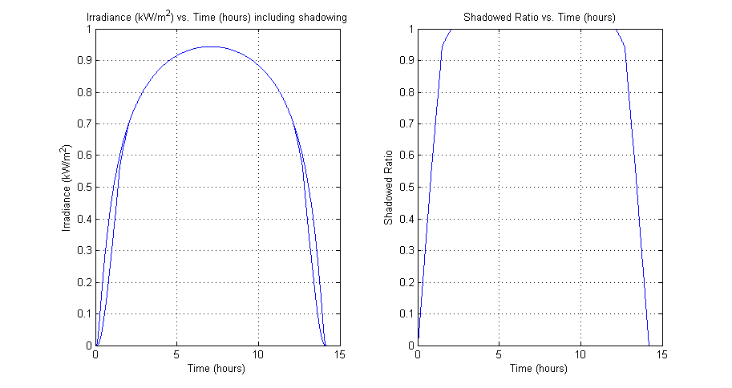
Shadowing for a Given Day
Day of Year: 172 (Summer Solstice)
Number of hours with sunlight: 14.19
Direct Irradiance lost due to shadowing: 3.52%

Slide 12
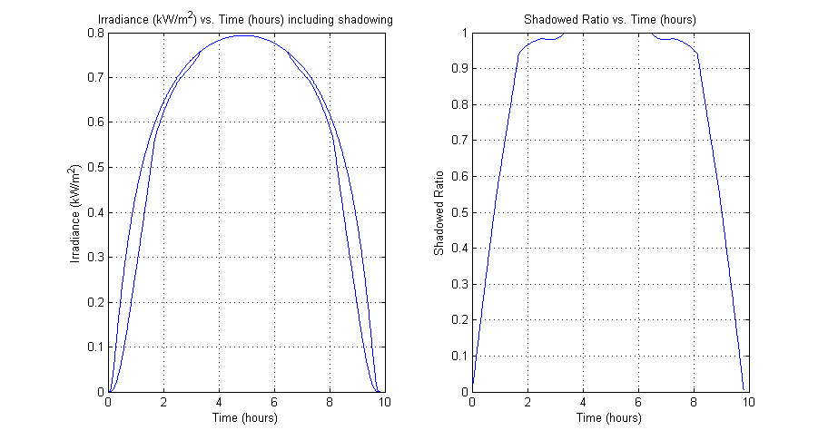
Shadowing for a Given Day
Day of Year: 355 (Winter Solstice)
Number of hours with sunlight: 9.81
Direct Irradiance lost due to shadowing: 7.73%

Slide 13
Thank You
Project Mentor: Dr. Roger Angel
of Steward Observatory

